Slide 1

PRISM (QUADRANGLE)
Prism’s Next Chapter: Data-Driven Solutions for Profitability.
Presented by
Mar Mohammed-Akram

Slide 2
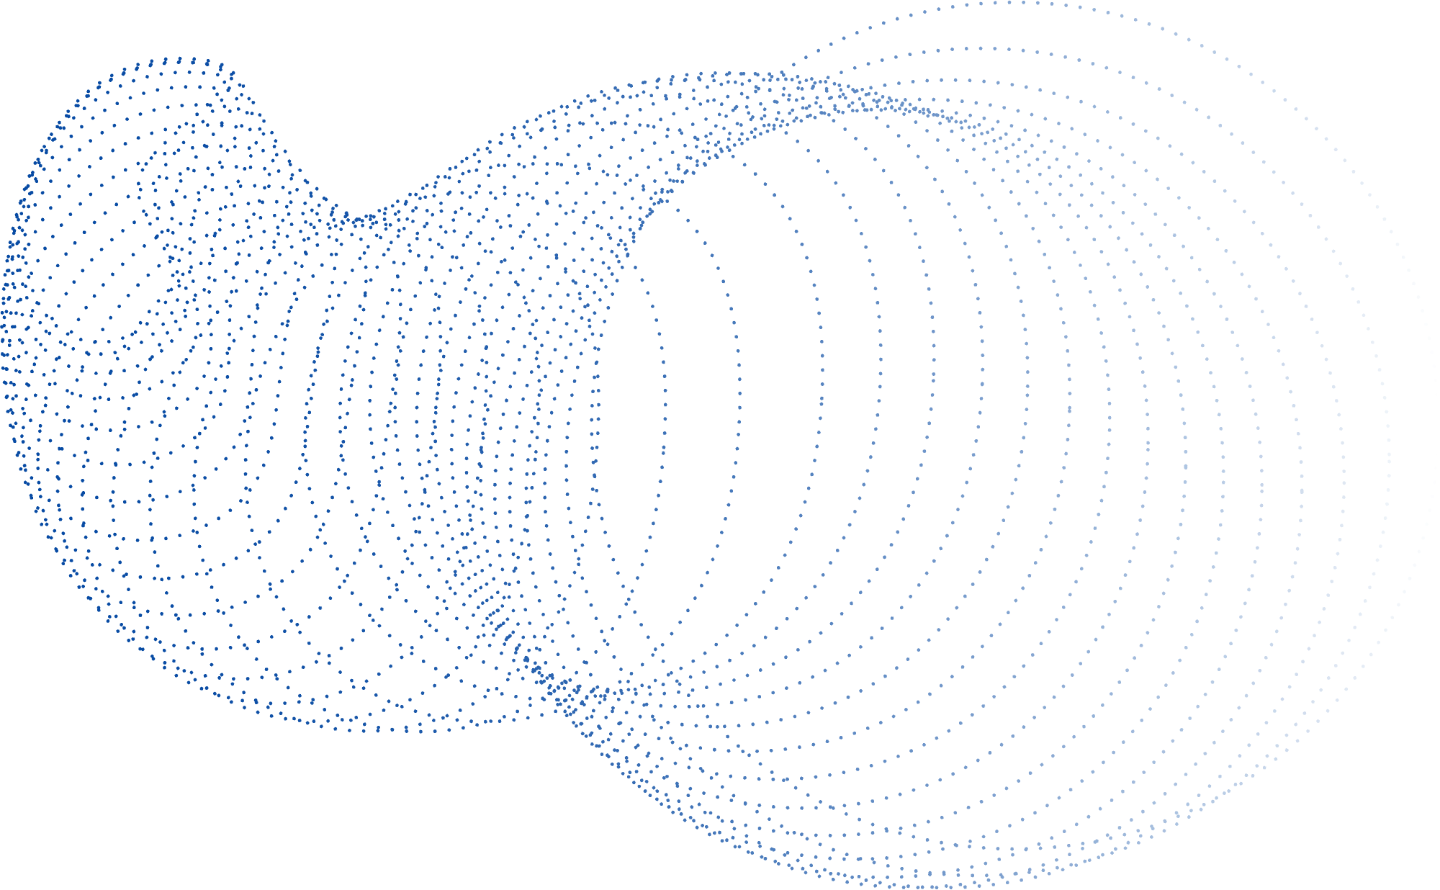
Discussion Points
AN OVERVIEW OF OUR GOALS, THE DATA, OUR PROGRESS AND WHAT’S NEXT...
Context & Business
Goals
Data
Insights
Impact of not
taking action
Recommendations
Notes:
The presentation covers our current situation, future goals, profitability insights, recommendations for growth, and the risks of inaction.

Slide 3

Context & Rationale
WHAT WE WANT TO ACHIEVE
WHY IMPROVE
IMPROVE OUR PROFITABILITY
INVEST IN SOCIAL MEDIA
By improving our profitability we can improve our sustainability, reinvest in our growth, survive market fluctuations, fund innovations.
With higher profitability, we can expand our social media presence & influencer partnerships, which are key growth drivers in today’s e-commerce market.
BE THE #1 ONLINE FASHION BRAND
PROVIDE BETTER SERVICE & MARKETING
Improved profitability as the #1 fashion e-commerce business gives us a competitive edge, helps us outperform competitors & boosts customer review.
Increased profits lets us streamline our services for better customer experience and diversify marketing strategies, such as B2B partnerships and events.
Notes:
At Prism, our goal is to be the top online fashion brand, and improving profitability is the key to achieving this.
Greater profitability will help us sustain growth, deal with market fluctuations, and fund innovations that will keep us competitive. It will also allow us to expand our social media reach, streamline app performance, and explore new marketing strategies—all aimed at elevating customer experience and staying ahead of competitors.

Slide 4


Data Insights
HOW CAN WE IMPROVE PROFITABILITY?
Notes:
How can our data help to answer our key business question, 'How can we improve our profitability?'

Slide 5
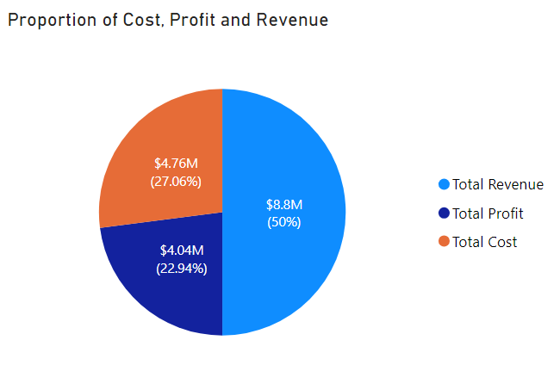
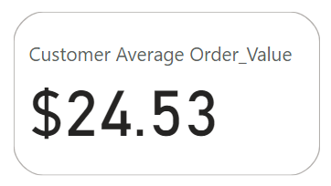
Our Numbers
We are spending more in costs than in making profit.
Our AOV is relatively low in comparison to the number of items we sell.
N.B. Currency is assumed to be USD
$724191.70
Notes:
Starting with some key numbers:
We made $8.8 million in 2020-2021, but our costs exceeded our profits by 4.12%, totalling approximately $724,000 more in expenses, which impacts our profitability. Additionally, our average order value is $24.53, which is low as an online fast fashion company.

Slide 6
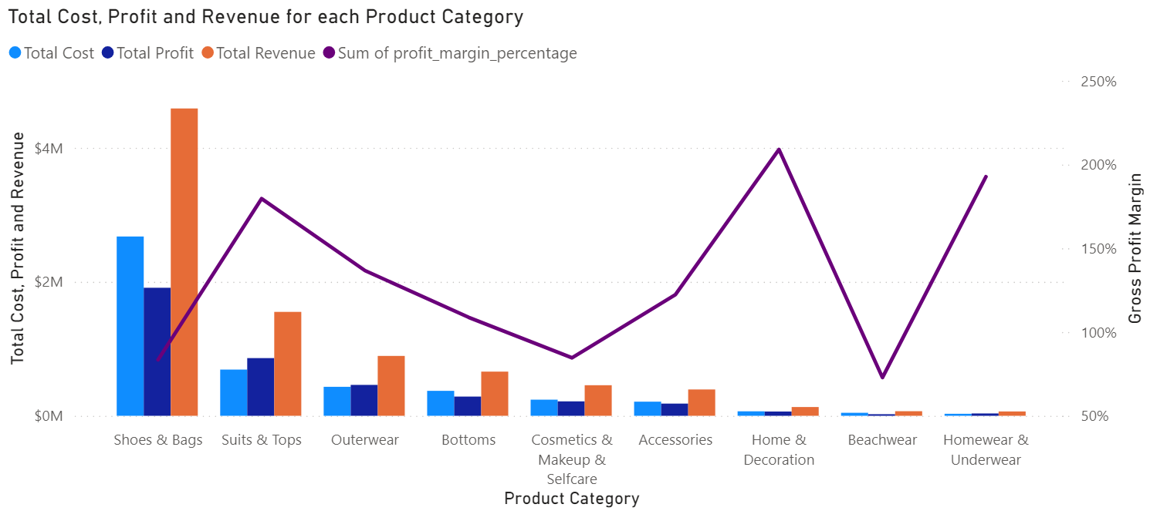
Financial Performance by Category
N.B. Main category was used as Product Category
Notes:
Our top-performing categories in revenue and profit are shoes & bags and suits & tops.
However, shoes & bags come with high costs due to materials, production, and return rates. While home & decoration and homewear/underwear have lower revenue, they maintain high profit margins (209% and 193%).
Beachwear, however, has low revenue and profit, highlighting an area for improvement.

Slide 7
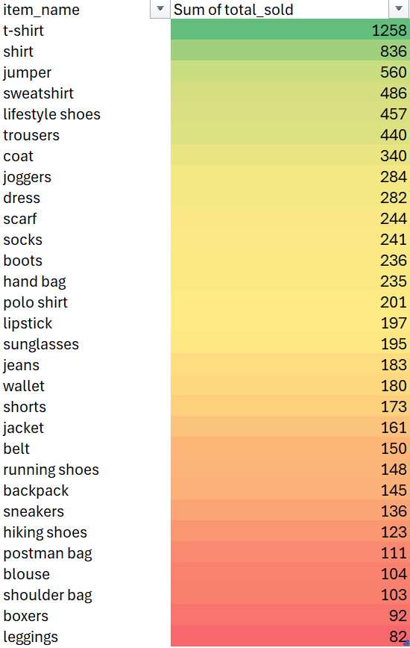
Slow Moving Inventory
Top 30 items from the bottom 20% of total sold.
Notes:
Touching on specific items, I have identified the top 30 items from the bottom 20% of total sales as SLOW MOVING INVENTORY.
I recommend discontinuing items that have sold under 100 units and discounting those with sales between 100 and 1,000 to improve profits.

Slide 8
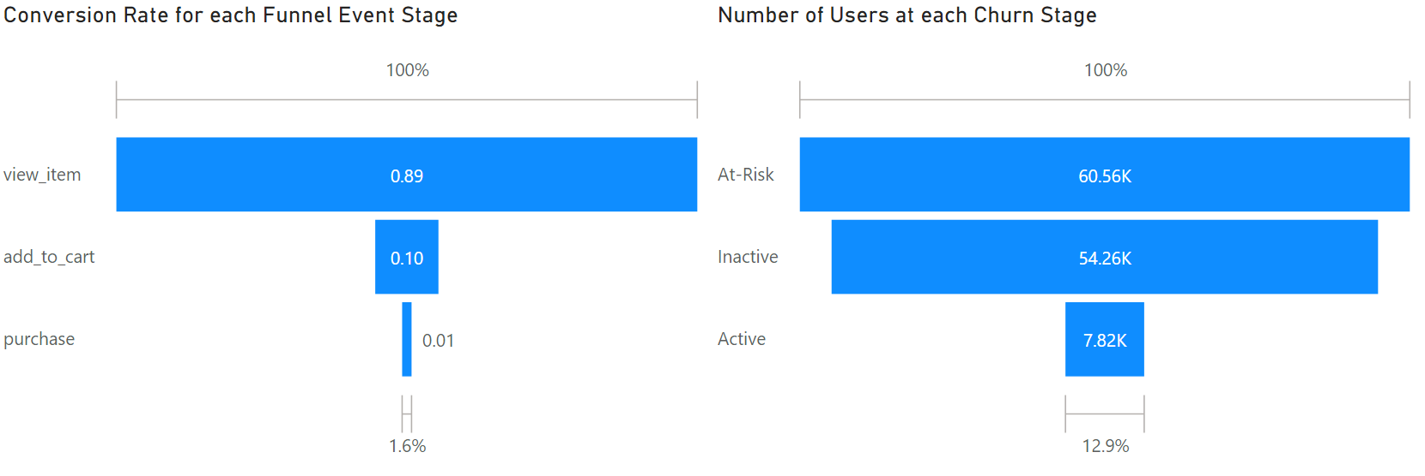
Conversion & Retention Challenges
19M
2M
315K
19M viewers
Only 10% of those, add to cart (2M)
Only 1% of that 19M will purchase
Conversion Rate = 1.6%
Notes:
The funnel analysis shows key drop-offs in customer journeys. We have many users view items, but only 10% add them to their cart, and just 1% of those complete a purchase—giving a conversion rate of just 1.6%. This low rate suggests potential barriers or insufficient motivation to move to the next stage.
Customer churn is also impacting our profits, with over 60,000 "At-Risk" users who could leave without re-engagement. Another large segment of "Inactive" users represent missed revenue but also an opportunity for targeted reactivation, as only 12.9% of users are active. This highlights an urgent need to boost customer engagement and retention.
Prism’s main customer base is concentrated in cities like London, Birmingham, and Leeds, presenting opportunities for targeted regional campaigns.

Slide 9
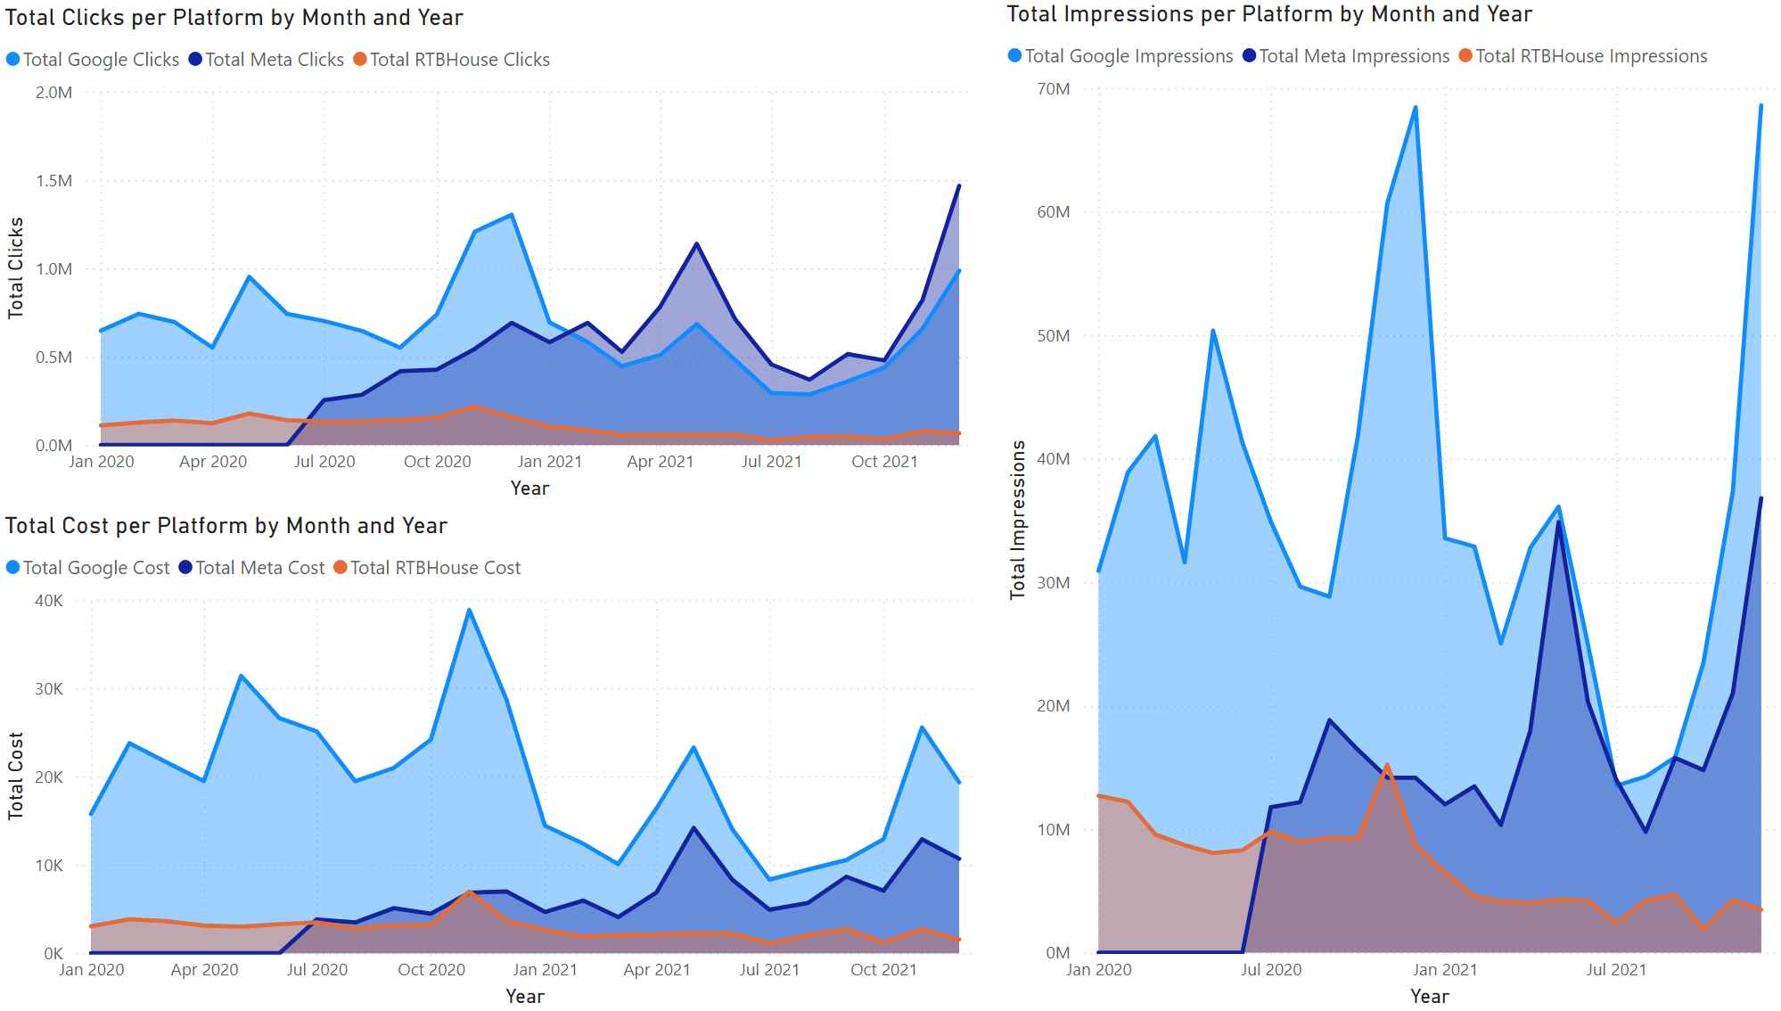
Ad Platform
Analysis
Google and Meta are driving significant traffic in 2020-2021.
Google’s higher cost may be justified by its click performance.
RTBHouse has low impact.
Notes:
Looking now at Ad platform data we can see on the top right that Google consistently has the highest clicks until January 2021 with Meta then taking over. RTBHouse remains low during this time.
Google and Meta costs also fluctuate with click volumes throughout time, with Google typically costing more.

Slide 10
Ad Platform Analysis
Google’s high impression values show its wide reach, which aligns with the high click volume, making it a valuable platform for ad visibility.
Notes:
Here, google impressions are consistently higher than Meta and RTBHouse, except in July 2021. RTBHouse impressions stay low but steady, likely due to Meta ads starting in June 2020. Google’s high impressions reflect its wide reach and high click volume, making it a valuable asset for ad visibility.

Slide 11

Actions for profitability
01
Focus marketing and inventory on high-profit categories; reassess low-profit ones.
02
Maintain revenue consistency (seasonal collections, seasonal bundles/discounts) and better cost management (e.g., renegotiate with suppliers)
03
Shift marketing budget to high-ROI channels and peak seasons (high demand).
04
Address churn and funnel event stages with re-engagement (personalised offers, discounters, loyalty programs).
05
Use upselling to boost sales.
Profit stagnation
Missed revenue chances
Customers move to competitors
Lack of innovation
INACTION
Notes:
Focus our marketing and inventory on high profit categories, reassess or remove categories like beachwear.
We need to mintain revenue consistency with seasonal collections and bundles
We should shift marketing budget to high return on investment channels, to cut RTBHOUSE, and peak seasons.
We should a ddress churn and conversion rates with targeted re-engagement
Try upselling to boost sales of slow moving inventory.
The risk of inaction here would be...

Slide 12

Thank you!
ANY QUESTIONS?
ALTERNATIVELY, PLEASE PING ME ON SLACK! @MAR MOHAMMED-AKRAM
Notes:
Thank you!

